Slide 1
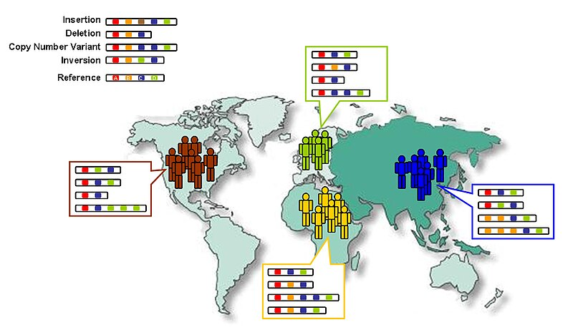

Curriculum representation learning with gene fusion evidence in cancer and healthy samples
Jacob Krol, 12/12/24
CSCI-7000-006, neurosymbolic-NLP

Slide 2
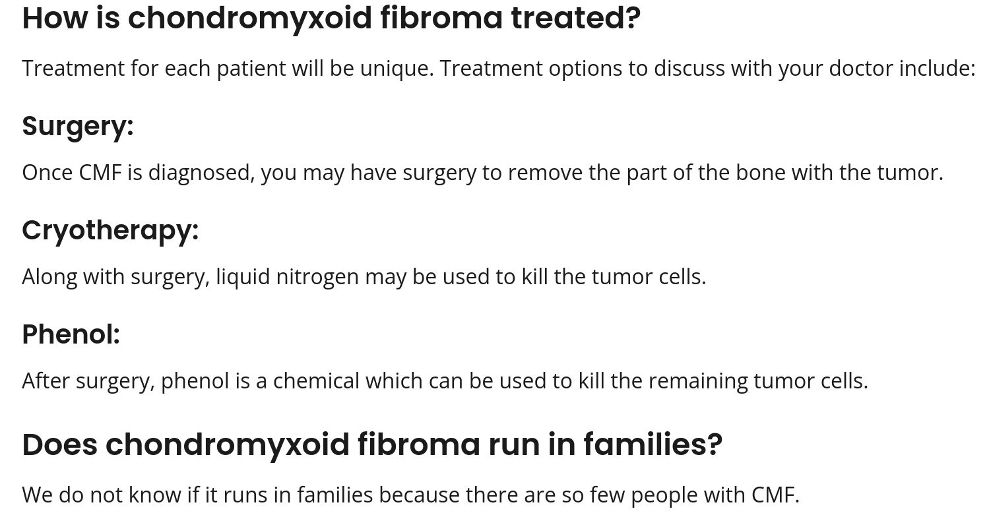

Motivation
Rare cancers tragically are hard to diagnose and treat

Slide 3
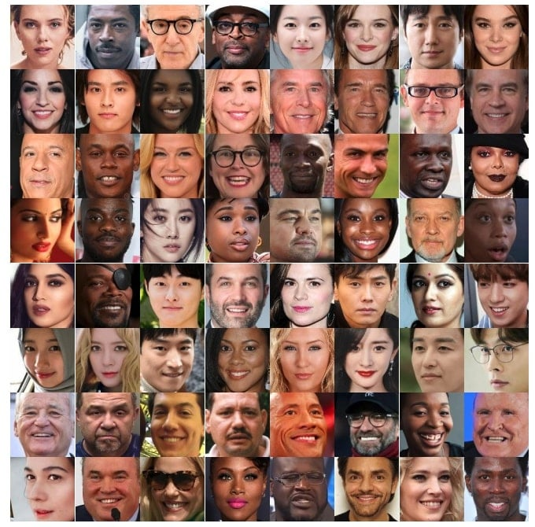
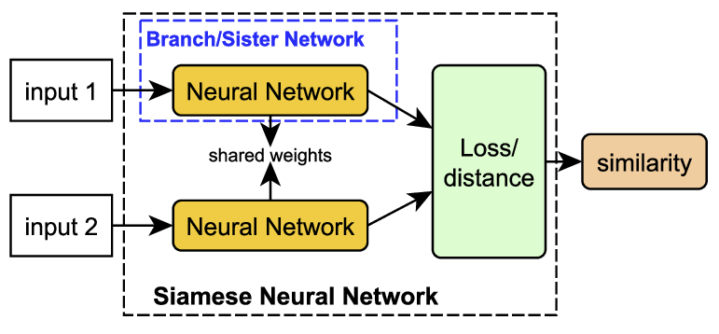

Motivation
Siamese neural networks learn representations from paired examples
Q: Can low dimensional representations of human genomes support genetics-driven similarity searches to find similar patients?

Slide 4
Data
1000 Genomes
(Healthy samples)
Pan cancer analysis whole genomes (Cancer samples)
Gene2gene
mutations
A 364486500 length vector for each person
Gene left
Gene right

Slide 5
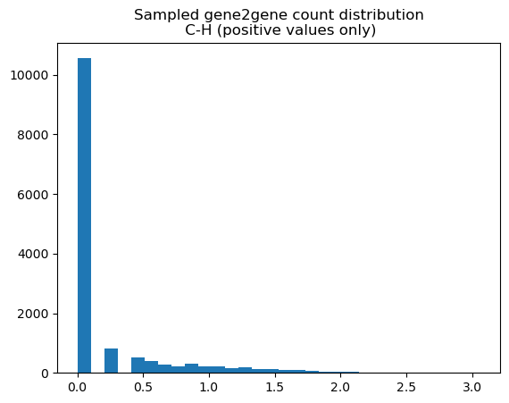
Dimensionality reduction
Encoding is sparse and heavy-tailed
Gene2gene evidence counts (feature values)
Log10(genefusion evidence+1)
Notes:
This plot is the distribution of values after flattening a gene2gene evidence matrix. The counts of all possible gene combinations.
Common dimensionality reduction techniques assume normally distributed and uncorrelated features
Assumptions do not hold for sparse, heavy-tailed genomic data,

Slide 6
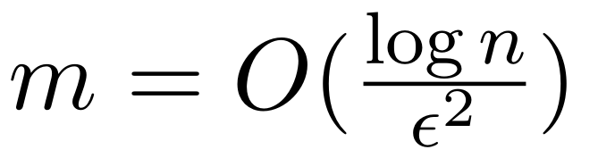
Johnson-lindenstrauss lemma
JL is ideal for small, high dimensional datasets
Common in genomics
Unfortunately, not an online model
Many variables (d)
Few samples (n)
Typical genomics dataset

Slide 7
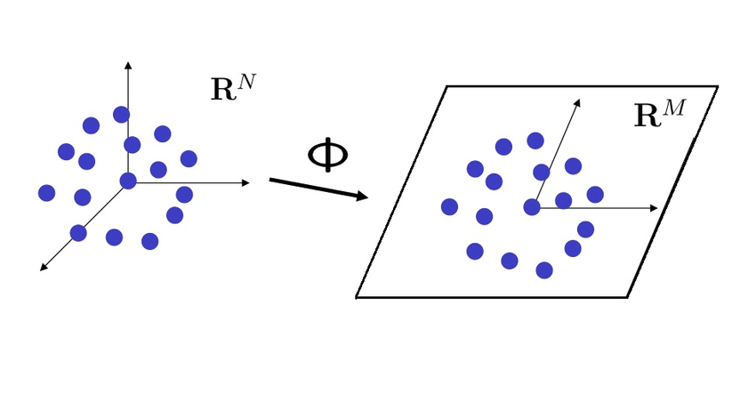
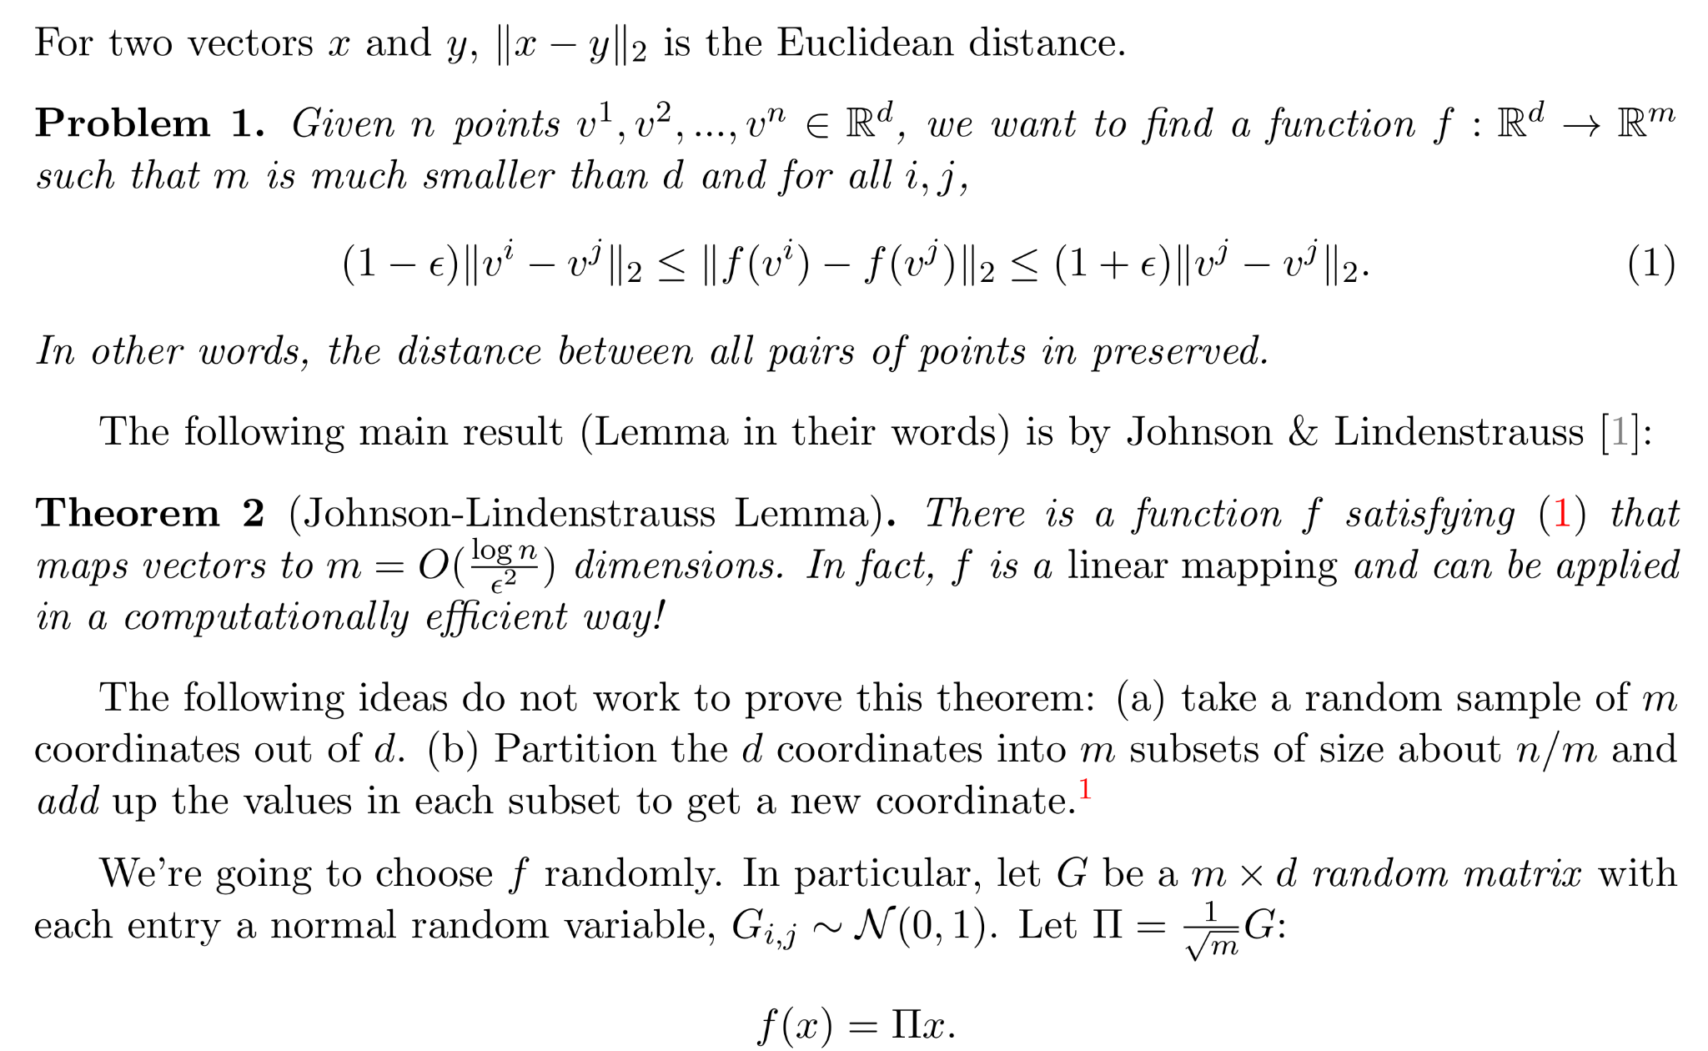
Johnson-Lindenstrauss lemma
(baseline)
Guarantees pairwise distances are preserved with fractional error
n := number of points
d := original dimensionality
m := reduced dimensionality
ϵ := fractional error
m Does not depend on d
Notes:
A random Gaussian matrix can transform n samples to m dimensions while preserving pairwise distances with error ϵ.
m is of n and ϵ only! Not d, the original dimensions
However, JL is not an online model.

Slide 8
Siamese network with symbolic components
Rule-based batch curation
Custom loss
Curriculum learning

Slide 9
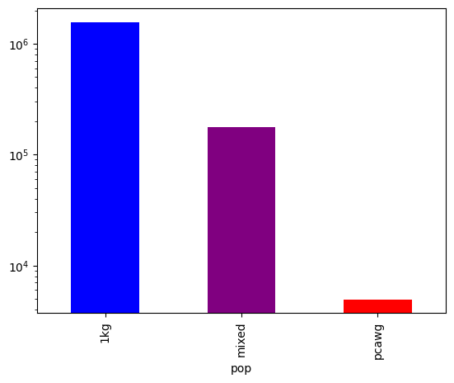
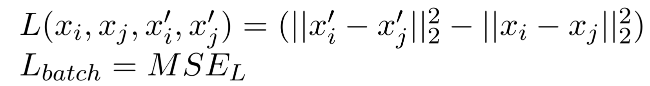
Symbolic component:
Curriculum 1 & population-aware batch construction
Curriculum 1: construct batch by alternating within population pairs
Count of population pairs is very imbalanced
1
Cancer
Cancer
2
Healthy
Healthy
3
…
Batch size

Slide 10
Curriculum 1: learn within population distances
Embedding distance
True distance

Slide 11
Symbolic component:
Curriculum 2 & contrast populations with triplet loss
Anchor
Positive
Negative
1
Cancer
Cancer
Healthy
2
Healthy
Healthy
Cancer
3
…
Batch size

Slide 12
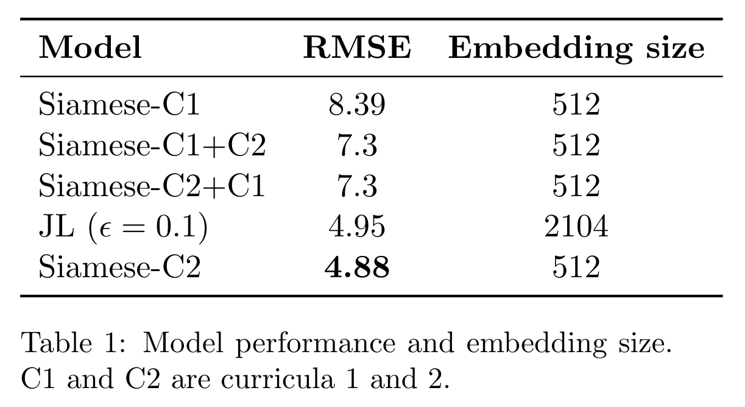
Notes:
Test size 10000

Slide 13
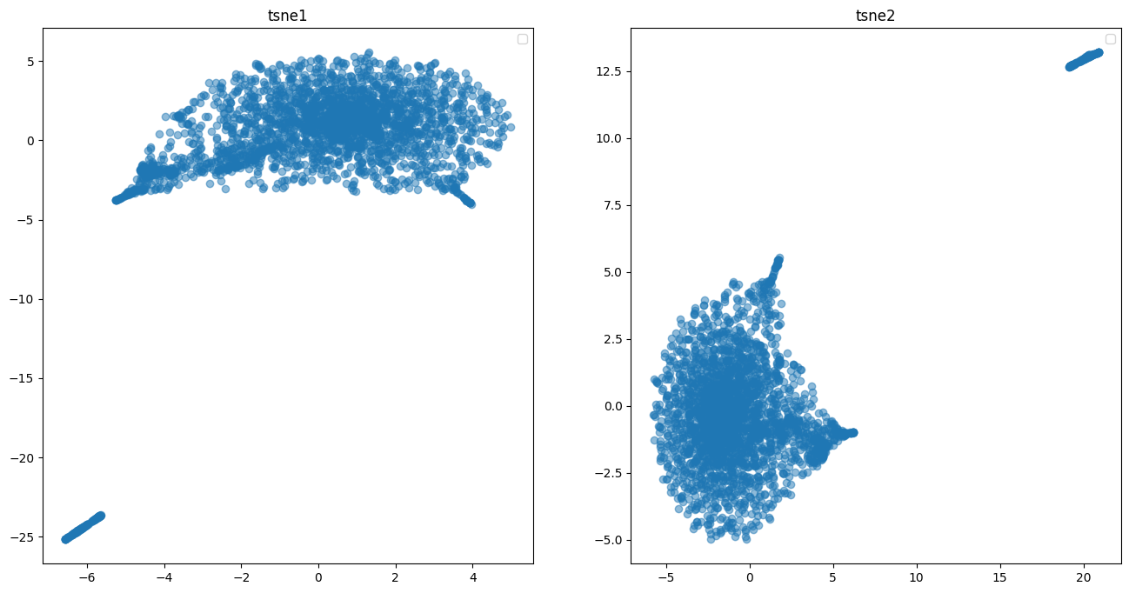
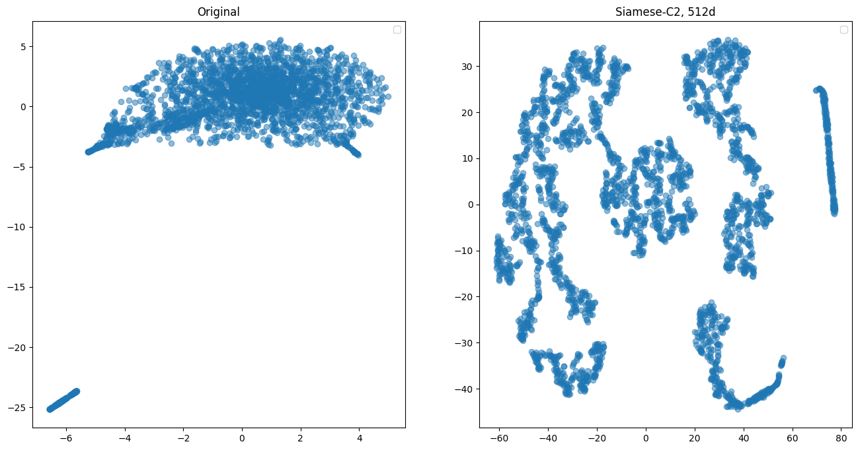
Qualitative results do not match RMSE
Untransformed
JL
Siamese-C2
JL looks great
Notes:
Siamese neural net

Slide 14
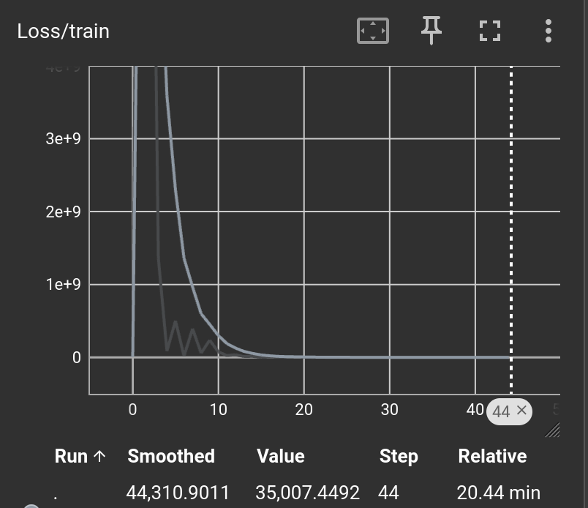
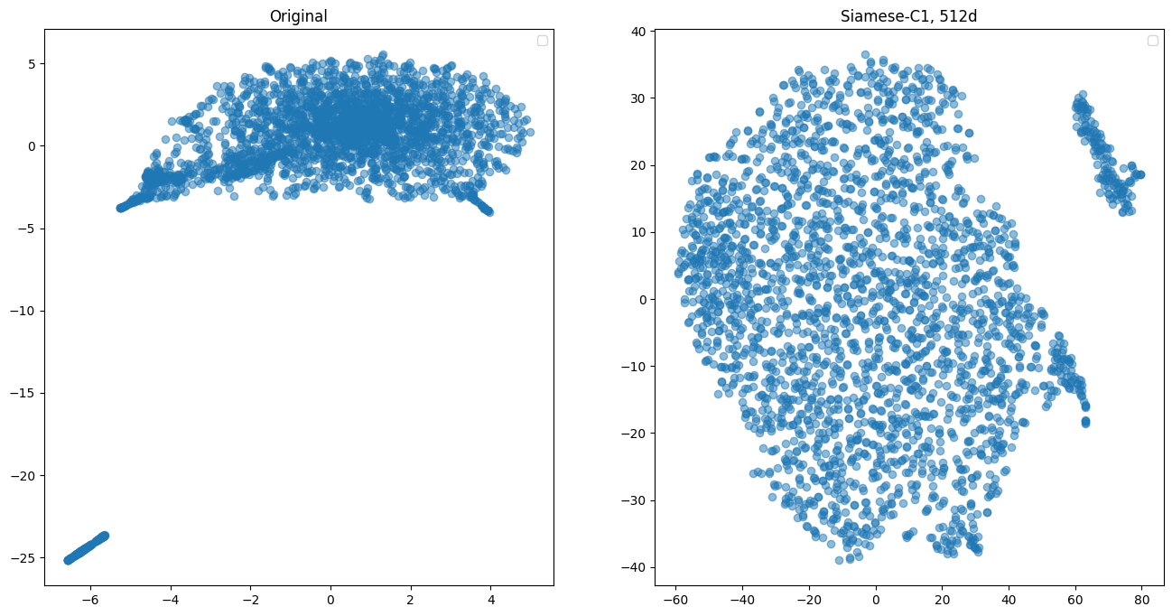
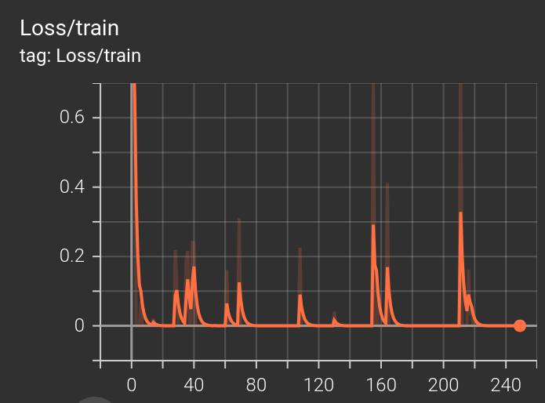
Training and qualitative analysis
Curriculum 1
Curriculum 2

Slide 15
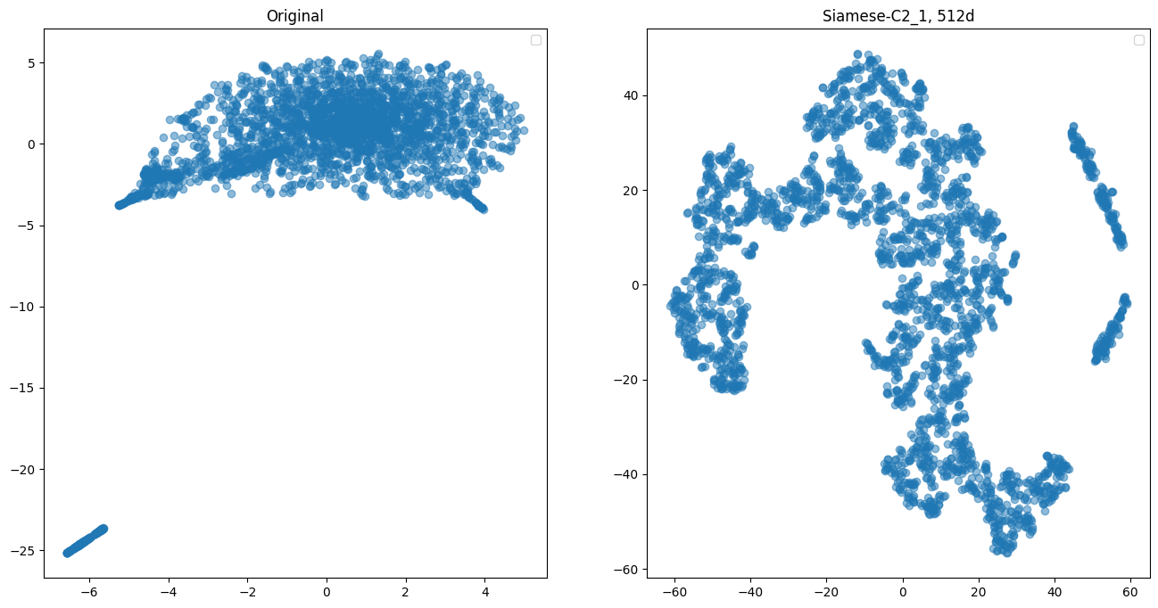
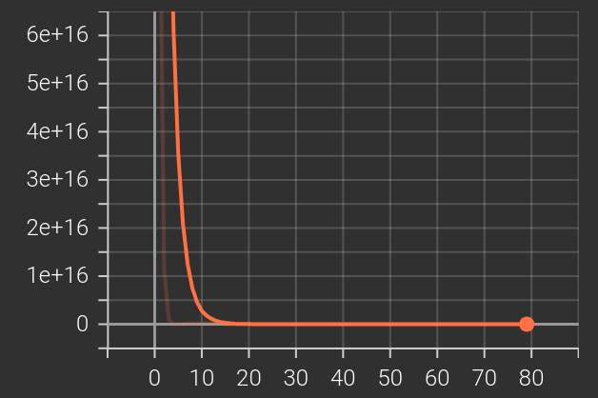
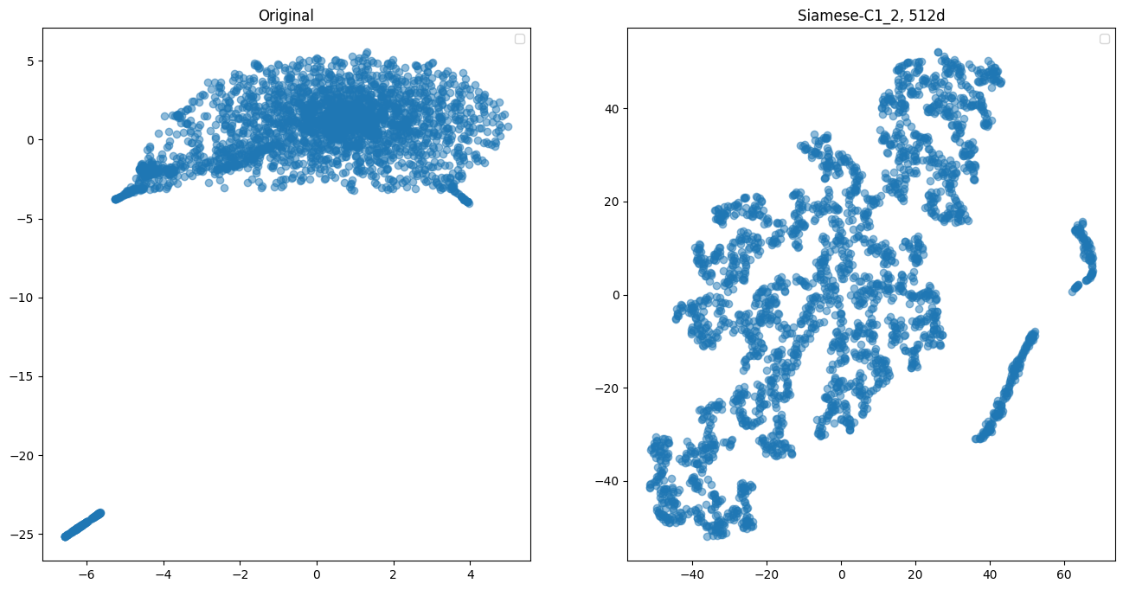
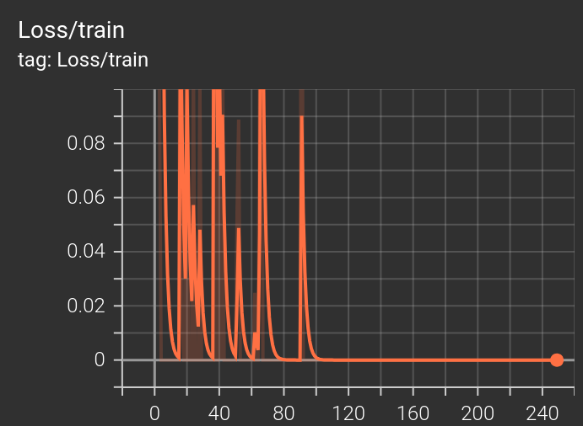
Training and qualitative analysis
Curriculum 2-1
Curriculum 1-2

Slide 16
Conclusions
Yes, low dimensional representations of sample-wise genefusions can be created with JL or learned by a siamese neural network
JL is effective, yet impractical
Siamese neural network learns population distances (triplet loss, curriculum 2)
Curriculum 1
Curriculum 2

Slide 17
Future directions
Add other cancers to see if sub-cancer clusters appear
Use normalized distance metric for ground truth (cosine)
Siamese architecture tuning
Embedding size
Hidden layers
Activation functions
Train and test with full data
Total number of sample pairs is 3643650
70/30 train/test split
Further sampling the train and test splits for practicality
The subsamples for train and test were the same across methods
Early stopping for Triplet objective
Weight freezing for curricula
Evaluation: compute loss separately for across and within pairs

